Slide 1
SAMPLING BASED MOTION PLANNING IN A DYNAMIC ENVIRONMENT
FOR A SMART TORPEDO
Anshuman Singh
Haixiang Fang (Nick)
Jaad Lepak
Notes:
Today My team consisting of Nick, Jaad and I, Anshuman Singh are going to present a sampling based algorithm for motion planning in a dynamic enviort

Slide 2

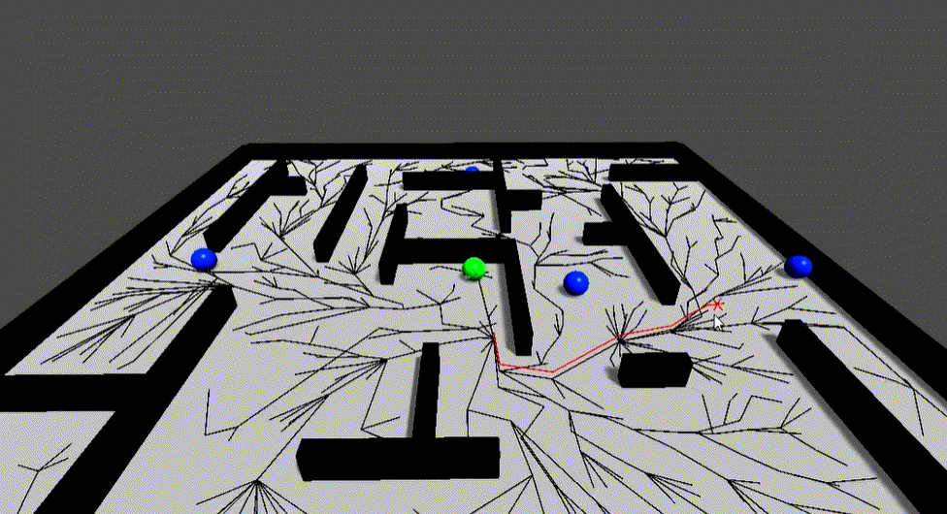
Introduction
Background
Why sampling-based?
Dynamic Obstacles
Reflect the changes of environment
Bi-Directional RRT*
source:https://www.youtube.com/watch?v=QLNSkFnBYuM
Naderi, Kourosh, et al. "RT-RRT*: a real-time path planning algorithm based on RRT.." (2015)
Notes:
Path planning in dynamic environments is a demanding problem encountered in many robotic tasks. A real-time path planning algorithm needs to be implemented and used to react to the changes in the environment as well as to constantly look for a better path to the goal point. Therefore, in our project, random obstacles have been introduced in order to replicate the occurrence of dynamic obstacles in the real world.
Existing heuristic, graph-based search algorithms like A* and Dijkstra, work well for static environment. But they do not provide us with optimal solution in real time and often become complex in nature for higher dimensional problems. Hence, we turn to sampling based algorithms like RRT,RRT* and Bidirectional RRT* and in this presentation we will show a variation of these algorithms which which re-plans on the go when an obstacle is encountered.

Slide 3
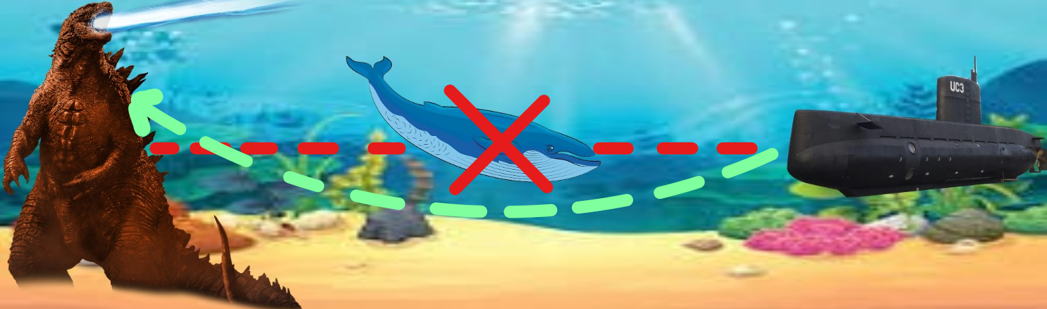

Goal
Solve for a torpedo’s underwater path from a submarine to a target, avoiding obstacles along the way
Account for both static and dynamic obstacles (e.g. elevated seafloor ranges, debris, wildlife, and water vehicles)
Notes:
The Goal of this project was to implement an algorithm to solve for a torpedo’s path from a submarine to a target in an environment consisting of both static and dynamic obstacles such as sea floor, sea life etc.

Slide 4
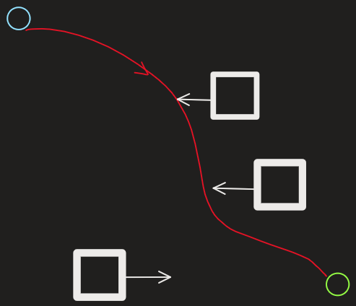
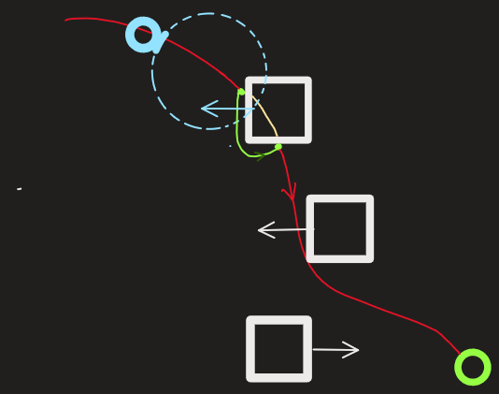
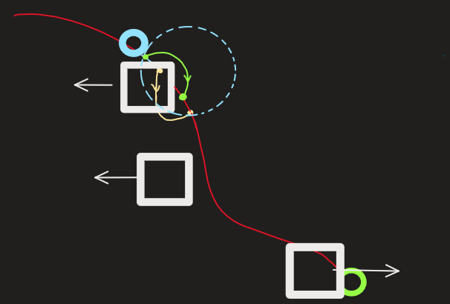
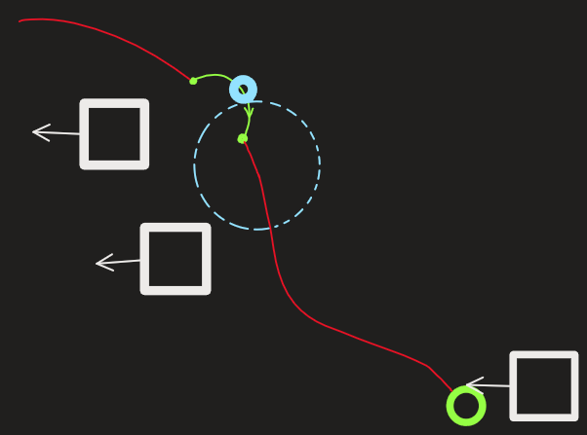
Proposed Methodology
1. Original optimal path is found
2. Circle region detects obstacle and alternate path is found
3. Alternate path blocked, another alternate path is found
4. Alternate path is used
Notes:
In our variation of sampling based algorithm we start by using bidirectional RRT* to find a path from a start node to a goal node while considering the obstacles are static. We will assume that the robot has sensors and can sense objects in front of it in an area shown by blue dotted circle. This path is called the Initial Path (shown in red line) . While looking ahead on the initial path, the robot moves towards the goal. If the robot senses an obstacle all the nodes of the initial path which are on the boundary of the obstacle and inside the obstacle (shown in with yellow line) are removed from the initial path. Next, we apply RRT to the immediate points outside of the obstacle and find a new "sub-path" (shown with a green line). The robot takes the "sub-path" to avoid the obstacles and then tries rejoin the initial path to continue towards the goal. If the robot encounters the obstacle while it traverses the "sub-path" it again discards the nodes inside the obstacle and finds a new sub-path to rejoin the initial path.

Slide 5
Implementation
Look at entire map and solve from start to goal while treating all obstacles as static. This path found is the original optimal path.
Begin moving the robot with a circle region in front of the robot used to detect obstacles.
If the circle region "collides" with an obstacle, perform region search.
Commit the same search algorithm from step 1 with different start and goal. The start is the robot's current position. The goal is chosen as 10 nodes along the original optimal path. The path found here is a diverging path, where the robot travels off the original optimal path, around the obstacle, and then back on to the original optimal path.
The robot only decides one divergent path at a time.
Notes:
I will go over the details of our implementation. First, we looked at the entire map with static obstacles. RRT was used to find a path from start to goal across the whole map, and this is labeled as the original optimal path. Then the robot begins to move. During movement, the region in front of the robot is used to detect obstacles. When the region intersects an obstacle, a second RRT search is performed. This time, the RRT searches for a diverging path from the robot's current position to a temporary goal. This temporary goal is located 10 nodes along the original optimal path. The robot then travels on this diverging path to avoid the obstacle and continue on the original optimal path. The robot only decides one divergent path at a time.

Slide 6


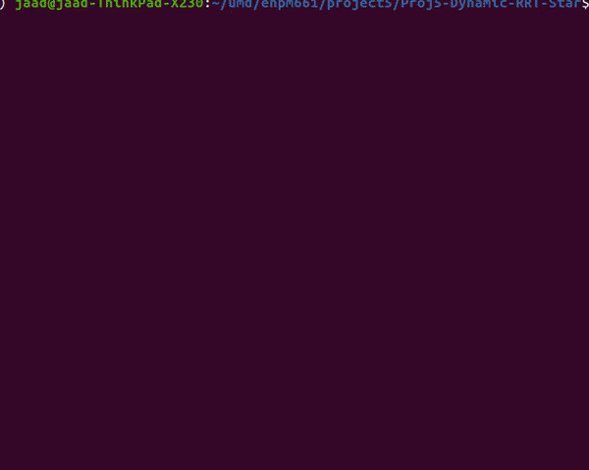
Results
First focused on building a dynamic obstacle environment
using different RRT search methods from start to goal
RRT-basic
RRT*
Bi-RRT*
 | RRT | RRT star | Bi-RRT star
Time Cost (s) | 59.07 | 60.68 | 19.73
Path Length (units) | 2292.27 | 1977.52 | 1894.25
Nodes Visited | 2016 | 1710.4 | 333
Time taken to find the optimal path (s)
RRT | RRT star | Bi-RRT star
0.3 | 1.1 | 0.17
Notes:
Start is a green circle
Goal is a red circle
The original optimal path is shown in red
Search region is a green hollow square
Robot is a black dot
Divergent paths are green
We evaluate the performance of 3 algorithms from 4 aspects, which are time taken to search the path, total time cost for robot movement, final path length and the total number of visited nodes in the path. Considering that the random nature of the sampling-based method, we ran each algorithm 10 times and took the average to get those data.
From the comparison,
RRT finds the path in a reasonable amount of time but it is not a smooth path and not close to optimal path.
RRT* finds a better path but it takes longer sometimes forever
Bi-directional RRT* offers the best trade-off between time taken and path cost. The path found is close to the optimal path and it takes only about a few seconds to find a solution.

Slide 7


Optimization
First used Bi-RRT* to get the original optimal path;
Then chose RRT-basic as the divergent path solution
Set the search region ahead of the current position
Re-plan to a temporary goal on the original path
Start is a green circle
Goal is a red circle
The original optimal path is shown in red
Search region is a green hollow circle
Robot is a black dot
Divergent paths are green
Notes:
Since the real world environment is more complicated, we improved our method to be more efficient.
Instead of making the current pos of the robot as the center of the search region. We chose several nodes forward and put the robot at the border of the region. So that the replaning function won’t be triggered if the obs is behind the robot.
Instead of replan to the final goal, we set 10 nodes ahead on the original path as our new temp goal.
While the robot is traveling along the new green path, the replan won't be triggered again until the robot reaches the new goal. Once the robot has reached the goal and will keep traveling along the original optimal path again.

Slide 8
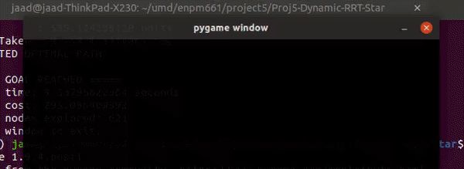
Limitations and Future Works
The robot can anticipate the obstacle's direction.
This allows the divergent path to exist "behind" the obstacle.
That way, the obstacle moves away from the robot and avoids collision while the robot is on the diverging path.
Notes:
ISSUES DEVIATIONS
We accomplished what we set out to in the initial proposal, but there are improvements that can be made. For example, this animation shows the robot diverging on a path that eventually collides with the obstacle. This can be avoided if the robot was able to anticipate the obstacle's direction. If we know the obstacle's direction, we can continue to run an RRT search until it gives us an optimal path that is behind the obstacle. Thus, the obstacle will continue to move away from the robot as the robot travels along the diverging path, avoiding collision.
Also, the team would like show their appreciation for the guidance of the professor and TAs this semester. We learned a lot about path planning and expanded our foundational knowledge on the subject of robotics. Thank you.

Slide 9
Thank you!

